Slide 1

Leaf Disease Detection System Using Machine Learning
Presented By Team :
Next

Slide 2

Introduction: The Challenge
Agriculture plays a vital role in ensuring food security, but crop production is often affected by various plant diseases. These diseases can reduce crop quality and yield if they are not detected at an early stage. Traditional methods of identifying plant diseases rely on manual inspection by experts, which can be time-consuming, expensive, and sometimes inaccurate. With the advancement of technology, Machine Learning (ML) provides an efficient solution for automatic disease detection. ML models can analyze leaf images and identify disease patterns quickly and accurately. A Leaf Disease Detection System using Machine Learning helps farmers detect plant diseases at an early stage and take timely action. This system improves crop productivity, reduces losses, and supports sustainable agriculture.
Next

Slide 3



Objectives
Early Detection of Plant Diseases
Accessibility
To identify plant diseases at an early stage using machine learning techniques to prevent crop damage.
Create a scalable, user-friendly platform for farmers.
Improve Accuracy in Disease Identification
Support Farmers in Crop Management
To provide accurate and reliable disease detection by analyzing leaf images using trained ML models.
To help farmers take timely preventive actions and improve crop productivity through quick disease diagnosis.
Next

Slide 4
Literature Review
Current state-of-the-art research highlights the shift from traditional feature engineering to Deep Learning architectures like Convolutional Neural Networks (CNNs).
CNN Dominance
Transfer Learning
Models like ResNet and EfficientNet have demonstrated superior feature extraction from leaf texture patterns.
Leveraging pre-trained models significantly reduces the volume of labelled training data required.
Next

Slide 5
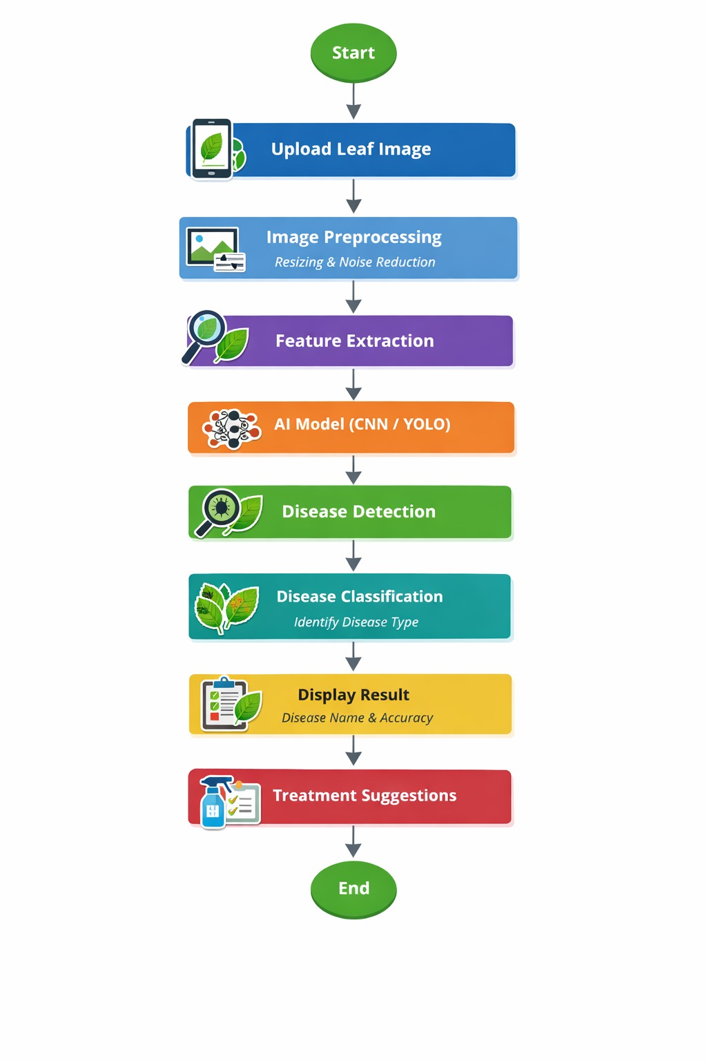
Design Phase
Data Collection
Preprocessing
CNN Architecture
Training/Validation
Next

Slide 6

Implementation
Next

Slide 7
Results and Discussion
The machine learning model successfully identified both healthy and diseased plant leaves using image analysis.
The trained model achieved good accuracy in classifying different types of leaf diseases.
The system provides faster results compared to traditional manual disease detection methods
It helps in detecting plant diseases at an early stage, which can reduce crop damage and yield loss.
The accuracy of prediction depends on the quality of the leaf images, lighting conditions, and background.
The system reduces the need for manual inspection by experts and saves time and effort for farmers.
The model performance can be improved in the future by using larger datasets and advanced machine learning techniques.
Next

Slide 8

Conclusion
The Leaf Disease Detection System using Machine Learning helps in automatically identifying plant diseases from leaf images.
The system provides quick and accurate detection compared to traditional manual methods.
Early detection of diseases helps farmers take timely preventive actions and reduce crop damage.
It reduces the need for expert inspection and saves time and effort in the disease identification process.
The system improves crop management and supports better agricultural productivity.
The performance of the model may depend on factors such as image quality and dataset size.
With future improvements like larger datasets and advanced algorithms, the system can become more efficient and useful for farmers.
Our model can be further improved by training it with larger datasets and advanced algorithms to accurately detect and
predict multiple types of leaf diseases.
Next

Slide 9


Future Enhancements
Cloud Integration
IoT Field Sensors
Real-time synchronisation for regional crop monitoring.
Integrating soil data with image-based diagnosis.
Next

Slide 10
THANK YOU
Home

